Slide 1
Predicting the outcome of terrorist attacks
Capstone Project Presentation
Josh You

Slide 2
The Problem
Terrorism is a social problem with large negative effects and is a major concern of security officials and the general public
Individual attacks, or attempted attacks, can vary in their outcome. Can we analyze what factors affect whether at attack will lead to any deaths?

Slide 3
Dataset
The Global Terrorism Dataset: 170,000 terrorist attacks from 1970 to 2016
Compiled by the National Consortium for the Study of Terrorism and Responses to Terrorism (START) at the University of Maryland
Includes attacks and attempted attacks

Slide 4
Dataset (cont.)
Dataset has over 100 columns:
Info on location, type of attack, weapons used, characteristics of the perpetrator and target, whether the attack succeeded, and outcome of the attack (deaths, injuries, property damage)

Slide 5
Data Cleaning
Removed rows with missing data – brought number of samples to ~140,000 from 170,000
Narrowed down variables to explanatory variables of interest – location region, attack type, target type, weapon type, and others

Slide 6
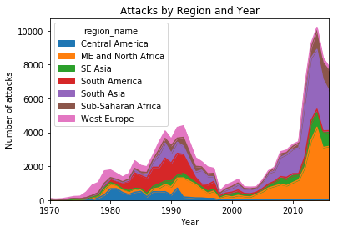
Exploratory Data Analysis – Region and Year

Slide 7
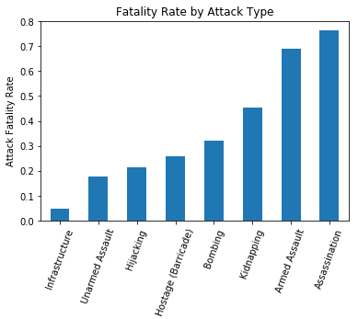
EDA – Attack Type

Slide 8
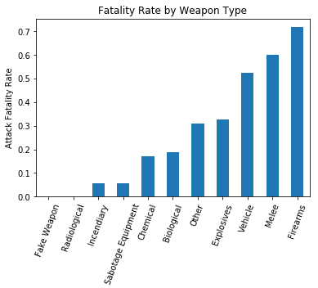
EDA – Weapon Type

Slide 9
Classification
Logistic regression resulted in 75.7% accuracy for predicting whether an attack leads to any fatalities (49% of attacks in the dataset were fatal)
Highest regression coefficients:
Suicide: 3.02
Assassination: 2.01
Utilities (target type): -1.37
Bombing: 1.17
Armed Assault: 1.09

Slide 10
Random Forests
Better accuracy than logistic regression: 79.86%
Most important features:
Longitude
Latitude
Firearms (weapon type)
Armed Assault
Suicide

Slide 11
Discussion
Location is a big factor, though government officials will largely be concerned with their own area
For weapons, bombs and firearms are associated with fatalities
Policymakers may wish to focus on arms control

Slide 12
Next Steps
Analyses focused on specific countries or areas
Utilizing more info on attacks – either in the START dataset or another source
Predict severity of outcome

